Slide 1

Orders Forecasting for ABB’s Electrification Products Division

Slide 2

Business Objective
PROBLEM STATEMENT
PROJECT OUTCOME
ABB is a leading global technology company that has wide range of operations & businesses across Electrification, Process Automation, Motion, Robotics & Discrete Automation divisions.
Objective is to ABB’s Orders forecasting for one of the largest division(Electrification Products).
Predicting the Orders for Electrification Products division at month level from November 2017 to March 2018.
01
03
Identification of factors that are affecting EP(Electrification Products) Orders and implementing hypothesis.
New variable that is a seasonality flag was created based on observation of sudden rise in EP Orders during a particular month in a quarter.
SOLUTION FRAMEWORK
02
04
Graphs and plots were used to visualize the amount of affect EP orders is having on the features
Final model was selected based on accuracy comparison for Time Series(ARIMA), Linear Regression and Random Forest.

Slide 3
Overall Methodology
Feature engineering & Selection:
Applying various transformations(lead, lag etc.)
Finalize variables to be fed into model
Results and Analysis:
Identification of final model based on accuracy.
Data understanding:
Variables understanding
Business Understanding and Research:
Understand about various services offered by ABB under EP division.
Understand data requirements for business problem and create hypotheses.
Exploratory Data Analysis:
Checking Outliers, missing values treatment.
Univariate and Bivariate analysis.
Modelling:
Implementation and evaluation of Time Series(ARIMA), Linear Regression, Random Forest.

Slide 4
Factor Map And Hypothesis
 | Variables | Definition | Hypothesis
1 | CPI (Consumer Price Index) | It measures the average change in prices over time that consumers pay for a basket of goods and services. It is most widely used for measuring inflation; a measure of how fast overall price is rising | A steady inflation rate indicates high demands; hence orders should be increasing. A declining inflation rate is due to less demand, hence less orders.
2 | WPI (Wholesale Price Index) – Electrical equipment's | It looks at the basket of wholesale goods, that is goods purchased in large quantities by businesses directly from manufacturers with the intent of reselling them to retailers. | A steady increase in WPI may be due to higher demand and growing economy, hence translate more orders.
3 | IIP (Index of Industrial Production) | It is an index that tracks growth activity in different sectors of the economy. | As IIP increases which depicts that there is growth in industrial production for various sectors over a month that results in increase of orders
4 | Imports | It involves bringing products or services into a country | Total number of imports over a month increase that tend to increase in orders.
5 | Electricity Requirement and Capacity | It is an electricity metric that tells you about the consumption and capacity of amount of electricity at month level. | As electricity requirement and capacity increase that directly shows a positive increase in orders.
6 | Exchange rate | Price of one currency in terms of another currency. | As exchange rate increases, orders decreases.
7 | Expectation Index | Measures future trends, affects current decision making behaviour in businesses. | As expectation index increases orders tend to increase.
8 | Raw Material Production | Production of Coal, Refinery products, steel and cement | As production in coal, Refinery products, steel and cement increase, hence increase in orders.
9 | Capital Expenditure Variable | Planning and execution of projects, costs for manufacturing, mining, services and execution. | Planning and execution of service projects and cost increases with increase of orders.

Slide 5
Exploratory Data Analysis

Slide 6
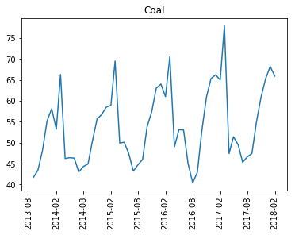
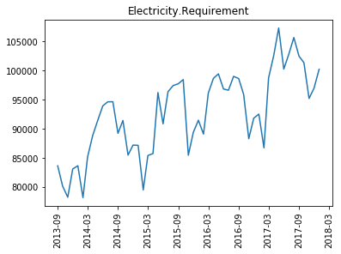
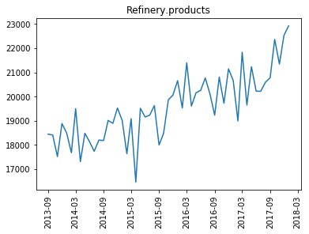
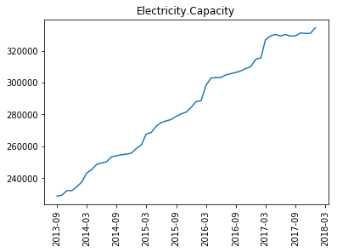
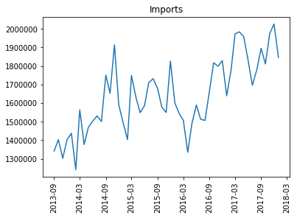
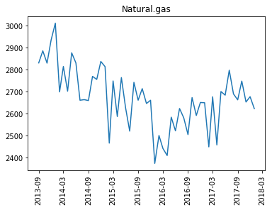
Missing Value Treatment
Features vary according to month/seasonality/quarter
Mean of values for corresponding month will give a better estimate
Features show approximate linear and steady increase in values
Linear interpolation to find a linear equation and use it to extrapolate data
Values do not show any pattern ( but overall increase in case of imports)
Mean of values to impute data
Mean of values in the years 2017-18 to impute data for Imports

Slide 7
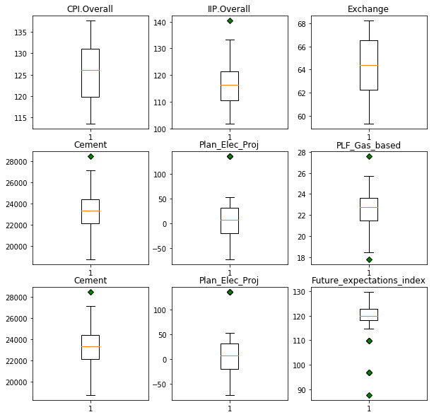
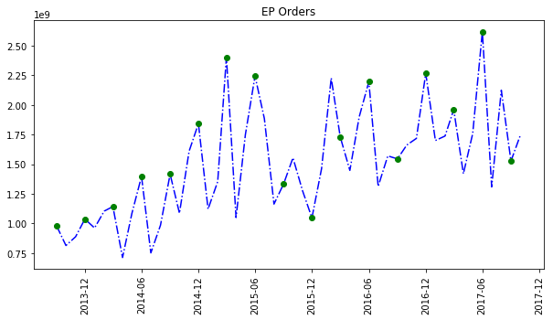
Univariate Analysis
Box Plots/Outlier Check
Seasonality Flag
Most features did not have outliers. Also, the number of outliers (if any) were very few. Outliers could an important indicator affecting ‘Orders’, hence they were not removed.
There is a spike in the number of orders in the third month of a quarter (quarter end). To account for this, a seasonality flag column was included in the dataset.

Slide 8
Lead – Lag Transformation
Raw values of Features
Lead-Lag Transformation
Observe Correlation Value for all Transformations
Select the best transformation if significant change
Features | Raw Data | Lag1 | Lag2 | Lead1 | Lead2
WPI Manufacturing of Electrical Equipment | 0.27 | 0.33 | 0.28 | 0.32 | 0.14
IIP Electricity | 0.51 | 0.5 | 0.49 | 0.53 | 0.61
Exports | -0.12 | -0.37 | -0.22 | -0.19 | -0.27
PMI_Services | 0.17 | 0.2 | 0.37 | 0.05 | 0.12
Current_Situation_Index | 0.26 | 0.42 | 0.4 | 0.16 | 0.05
Future_Expectation_Index | 0.51 | 0.57 | 0.54 | 0.46 | 0.41
PLF_Gas_Based | -0.09 | -0.16 | -0.28 | -0.09 | -0.08
Natural.gas | -0.35 | -0.51 | -0.41 | -0.38 | -0.36
Exec_Serv_Cost | 0.29 | 0.32 | 0.33 | 0.35 | 0.54
Plan_Serv_Proj | 0.1 | 0.06 | 0.2 | 0.12 | 0.14
Plan_Maf_Cost | 0.34 | 0.36 | 0.43 | 0.27 | 0.22
Plan_Min_Cost | 0.33 | 0.43 | 0.42 | 0.13 | 0.06

Slide 9
Modeling Process

Slide 10
Analytical Dataset and Modelling Process Overview
Remove Non-Correlated Features
Feature Selection
Find Pearson Correlation of features with target variable
Drop features with correlation < 0.2
40 features left (14 features dropped)
Run OLS regression result to observe p-values
Plot feature importance
Observing the p-values and feature importance. Drop appropriate feature
Rerun and see results again
Reduce Multicollinearity
Final Analytical Dataset and Modelling
Continue the previous process until we get appropriate p-values
Remaining features form part of final dataset
Run LR and RF models on this dataset
Tune required parameters and observe error metric
Print VIF values and drop the feature with highest VIF
Rerun and continue the same process to bring VIF values down (25 features left)

Slide 11
Model Building for predicting the Trial Subscriptions
70%
30%
100%
Use this to run and validate different models for predicting ‘Orders’
TRAIN DATASET
TRAIN DATASET
PREDICTION DATASET
Variables | Coefficient | Variable Interpretation | P-values
(intercept) | 6.151e+09 | EP Orders when all the features are zero | 0.012
IIP.Mining | 2.133e+07 | With 1 unit increase in the IIP index of Mining, the uplift of EP Orders is 2.133e+07 | 0.001
Exports | -909.2655 | With 1 unit increase in the Exports, the decrease of EP Orders is -909.2655 | 0.031
Imports | -555.9150 | With 1 unit increase in the imports, the decrease of EP Orders is -555.9150 | 0.145
Electricity.Requirement | 1.561e+04 | As the Electricity requirement increases by 1MW then increase of EP Orders is 15.61K | 0.054
Natural.gas | -1.156e+06 | With 1USD/MMBtu increase in the production of Natural gas, the decrease of EP Orders is -1.156e+06 | 0.022
Refinery.products | -8.359e+04 | 1 MCM Increase in the production of refinery products will decrease the EP Orders by -83.59K | 0.108
Cement | -7.627e+04 | 1 thousands tons Increase in the production of cement will decrease the EP Orders by –76.27K | 0.028
Plan_Serv_Proj | 1.303e+06 | As the number of Planned Projects in service sector increase by 1 unit, EP Orders will increase by 1.303e+06 | 0.002
Exec_Serv_Proj | -1.447e+06 | As the Number of Projects that are completed in service sector increase by 1unit, EP Orders will decrease by -1.447e+06 | 0.000
Plan_Serv_Cost | 2177.4730 | With 1USD increase in the cost of Planned Projects in service sector, EP Orders will increase by 2177.4730 | 0.022
Exec_Serv_Cost | 4793.5737 | 1USD Increase in the cost of Projects that are completed in service sector will increase the EP Orders by 4793.5737 | 0.000
Seasonality | 4.614e+08 | At the end of the month of each quarter EP Orders have a rise of 4.614e+08 | 0.000
R Squared | 90.9%
Adjusted R Squared | 85.2%

Slide 12
Modeling Results and Insights

Slide 13
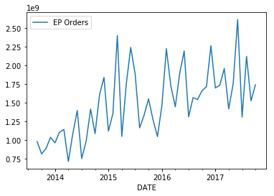
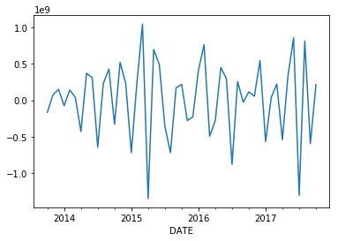
Running Different Models
Time Series (ARIMA)
Random Forest Model
Features in the final analytical dataset and default parameters was used as a rf base model
Random Search was used to tune the hyperparameters for improving accuracy of the model
The best parameters result from Random Search used in the final model.
EP Orders is following a trend, there is no stationarity as the mean is constantly changing over time
By differencing current value to its previous value, we have made the time series stationary
Hyperparameters Used
Random Forest
n_estimators = 683
max_depth = 5
max_features = ‘log2’ (4)
Linear Regression Model
The features in the final analytical dataset was used as the training data for the LR model
The model was trained on the complete dataset and orders for 5 months were predicted

Slide 14
Model Selection and Insights
Overall Accuracy
Insights and Summary
Model | MAPE | Accuracy
Linear Regression | 30% | 70%
Time Series (ARIMA) | 27% | 73%
Random Forest | 23% | 77%
In case of some features, the orders for a month depend more on the indicators(value) of previous months
1
2
Seasonality flag is an important flag. Using seasonality flags give more accurate results
3
LR and RF models could account for the spike in orders for the quarter end months
Random Forest shows the best overall accuracy among the three models
Random Forest also accounts for the spike in orders in quarter end months
4
Random Forest is selected as the best model
For plots click here

Slide 15
Thankyou

